Slide 1
Capstone Project
Study of MATLAB/Simulink and application on simulation and analysis of mechanical components of the (complete) EPS system
Instructor: PhD. Ngô Đắc Việt
PhD. Trần Đăng Long
Student: Hồ Bình Minh - 1852169
Trịnh Tiến Long - 1852047

Slide 2
Table of content
1. Plan, abstract and objectives
2. Analyze general mechanics model of EPS
3. Tire dynamics in EPS and its impact

Slide 3



I/ Plan
Week 5: Synthesis of theories, articles, old results + planning
Week 6: Bringing the wheel model into Matlab/Simulink
Week 7: Connect to the 3DOF car model
Week 8: Find the parameters of the full car article
Week 9: Add new parameters to compare result with research paper
Week 10 : mid-term report
Week 11: Find a formula that relates the direction of the car's motion to the rotation of the steering wheel
Week 12 : Apply to Matlab/Simulink
Week 13: Synthesize, write the overall project report
Week 14 : Poster printing, final editing
Week 15: Final report

Slide 4
I/ Abstract and objectives:
Vehicle steering dynamics is an essential topic in development of safety driving systems. These complex and integrated control units require precise information about vehicle steering dynamics, especially, tire/road contact forces. In the term of interaction between tire force and road surface, we are going to primarily focus on the aligning moment which is the factor that urges the tires to steer. This aligning moment that causes this will be described in below when considering the slip angle, the mass of vehicle, wheel alignment lateral force generation and longitudinal force generation. Through this capstone project, this torque will be fully showed with the theoretically corresponding equation and combine with the result diagrams by using MATLAB software.
=> Completely build the steering dynamics model between the tire forces and road surfaces that corresponding with the wheel alignment as well as modelling into MATLAB to simulate how relevant factors that can affect to the aligning moment.

Slide 5
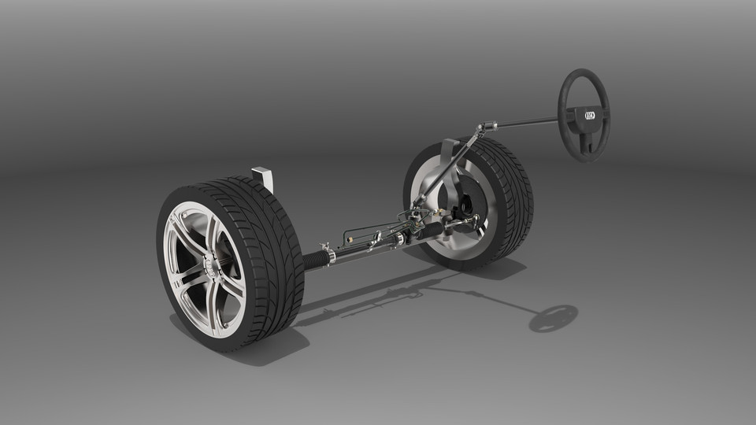
Analyze general mechanics model of EPS

Slide 6
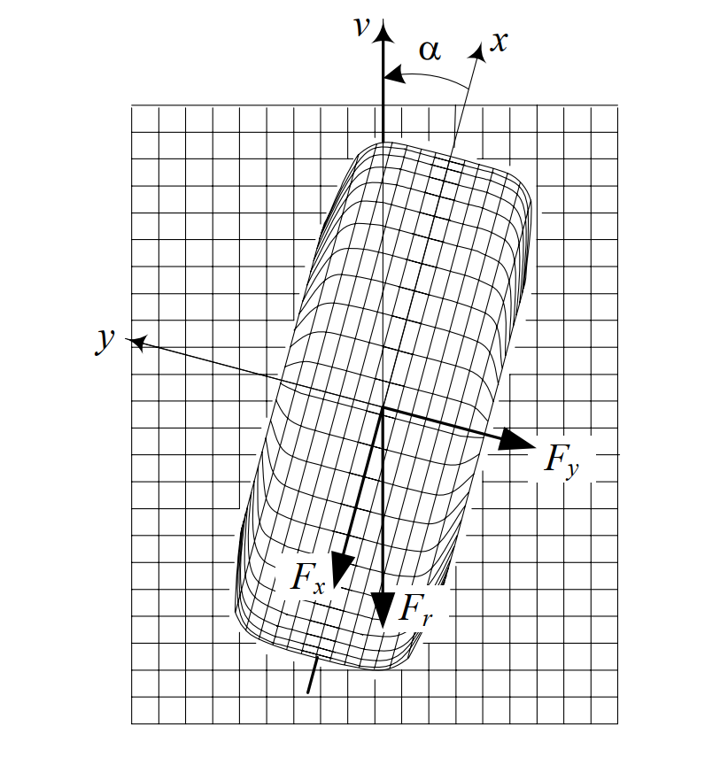
III/ Tire dynamics:
Forces:
Longitudinal force:
Lateral force:

Slide 7
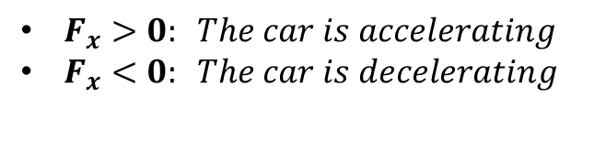
III/ Tire dynamics:
Force:
Longitudinal force: is the force acting on the x-axis of the vehicle
$F_{x}>0: The car is accelerating$
$F_{x}<0: The car is decelerating$

Slide 8
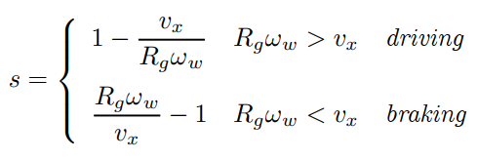
III/ Tire dynamics:
Force:
_ The magnitude longitudinal force can be affected by slip ratio:
Notes:
Longitudinal slip ratio is the ratio between the unloaded velocity of the tire and the actual velocity of the tire.

Slide 9


III/ Tire dynamics:
1) Force:
Lateral force: is the frictional force to the centrifugal when the driver steers. Besides, it also create the sideslip angle.
Notes:
Cornering stiffness: Độ cứng khi vào cua của bánh xe

Slide 10
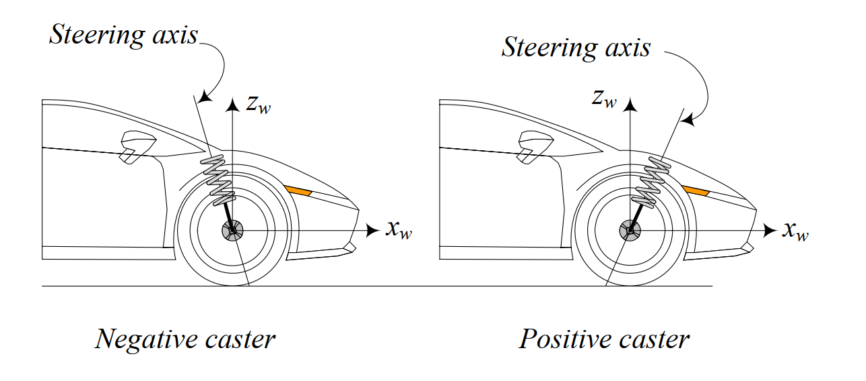
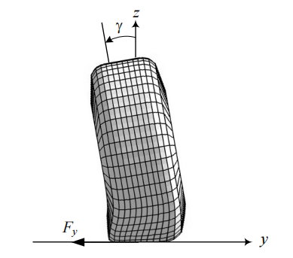
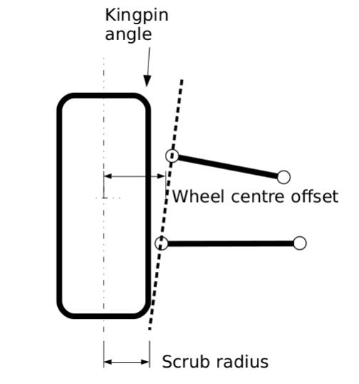
III/ Tire dynamics:
2) Wheel Alignment:
Caster angle
Kingpin angle
Camber angle
Notes:
Cornering stiffness: Độ cứng khi vào cua của bánh xe

Slide 11
III/ Tire dynamics:
2) Wheel Alignment:
Caster angle: is the angle between the steering axis and normal axis of the vehicle
Notes:
Caster angle affects the steering feel by creating a self-centering torque to reduce the toughness of steering.

Slide 12
III/ Tire dynamics:
2) Wheel Alignment:
Kingpin angle: is the angle between the suspension steer axis relative to vertical in front view.
Notes:
Caster angle affects the steering feel by creating a self-centering torque to reduce the toughness of steering.

Slide 13
III/ Tire dynamics:
2) Wheel Alignment:
Camber angle: is the angle between the vertical axis of the wheel and the vertical axis in front view of vehicle.
Notes:
Caster angle affects the steering feel by creating a self-centering torque to reduce the toughness of steering.
Lấy mô hình cụ thể, lấy trong sách cơ khí, quay quanh hệ thống treo, tìm bài báo về wheels.

Slide 14
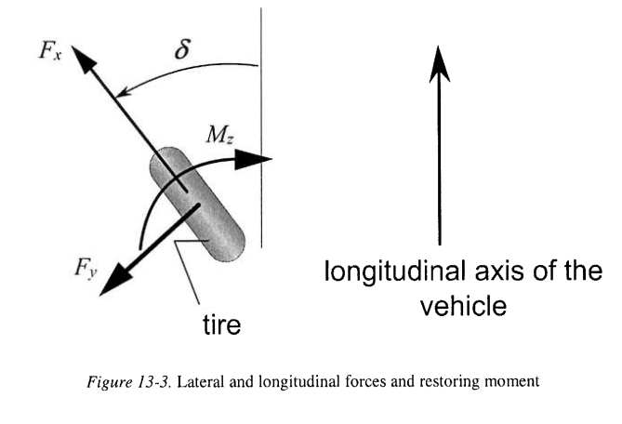
Tire dynamics
In this part we focus on :
Fx : longitudinal foce of tire
Fy : lateral force of tire
Mz : aligning moment of tire
Notes:
Vehicle Dynamics and Control (Mechanical Engineering Series) (usp.br)

Slide 15

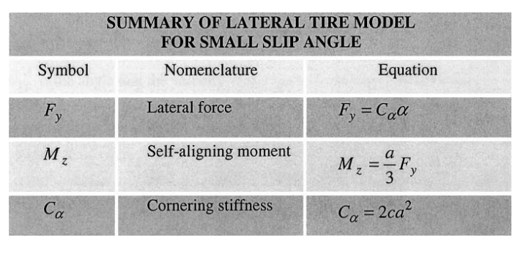
Tire dynamics
Equation for these parameters is shown on table. In this research, only small slip angle is in use.
Where:
c be the lateral stiffness per unit length of the tire
α be the slip angle at the tire
The cornering stiffness Cα
Source: Vehicle dynamics and control by Rajesh Rajamani
Notes:
Vehicle Dynamics and Control (Mechanical Engineering Series) (usp.br)

Slide 16
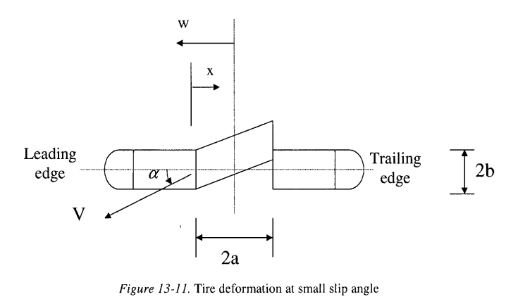
Tire dynamics
Equation for these parameters is shown on table. In this research, only small slip angle is in use.
Where:
2a is length of contact area of tire while contacting the surface
Source: Vehicle dynamics and control by Rajesh Rajamani
Notes:
Vehicle Dynamics and Control (Mechanical Engineering Series) (usp.br)

Slide 17
Matlab model:

Slide 18
Result

Slide 19
